Slide 1
ENGINEERING JUDGMENT CE 4200 Professional Engineering Practice Issues
Spring 2022 Semester
William D. Lawson, P.E., Ph.D.

Slide 2
BASIS FOR INQUIRY
CRITICAL THINKING &
ENGINEERING JUDGMENT
Professional Engineering Practice Issues

Slide 3

BOK3 Outcomes
Mathematics
Natural Sciences
Social Sciences
Humanities
Materials Science
Engineering Mechanics
Experimental Methods and Data Analysis
Critical Thinking and Problem Solving
Project Management
Engineering Economics
Risk and Uncertainty
Breadth in Civil Engr Areas
Design
Technical Depth
Sustainability
Communication
Teamwork and Leadership
Lifelong Learning
Professional Attitudes
Professional Responsibilities
Ethical Responsibilities

Slide 4
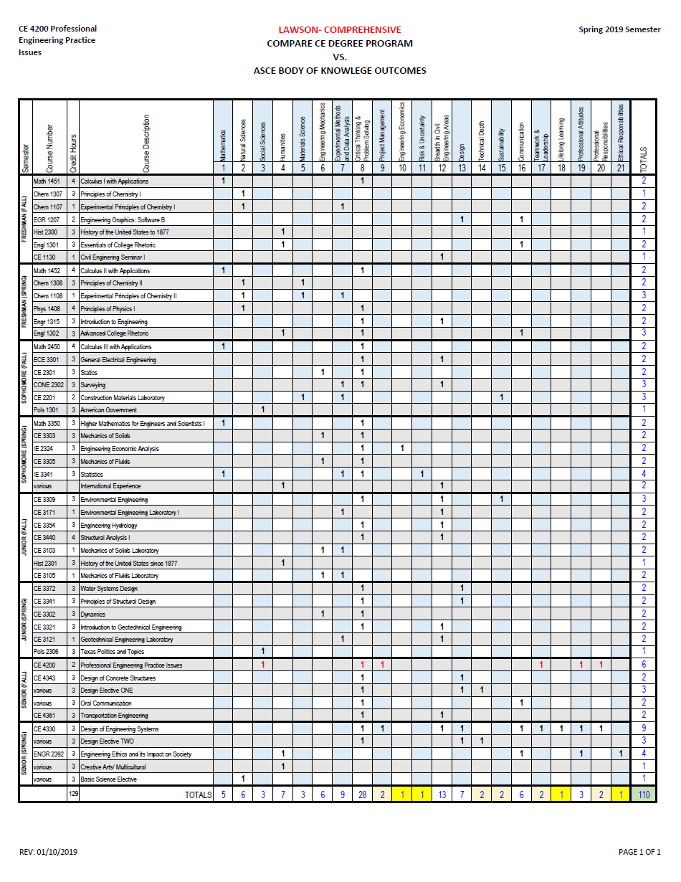
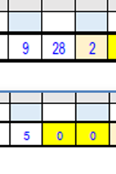
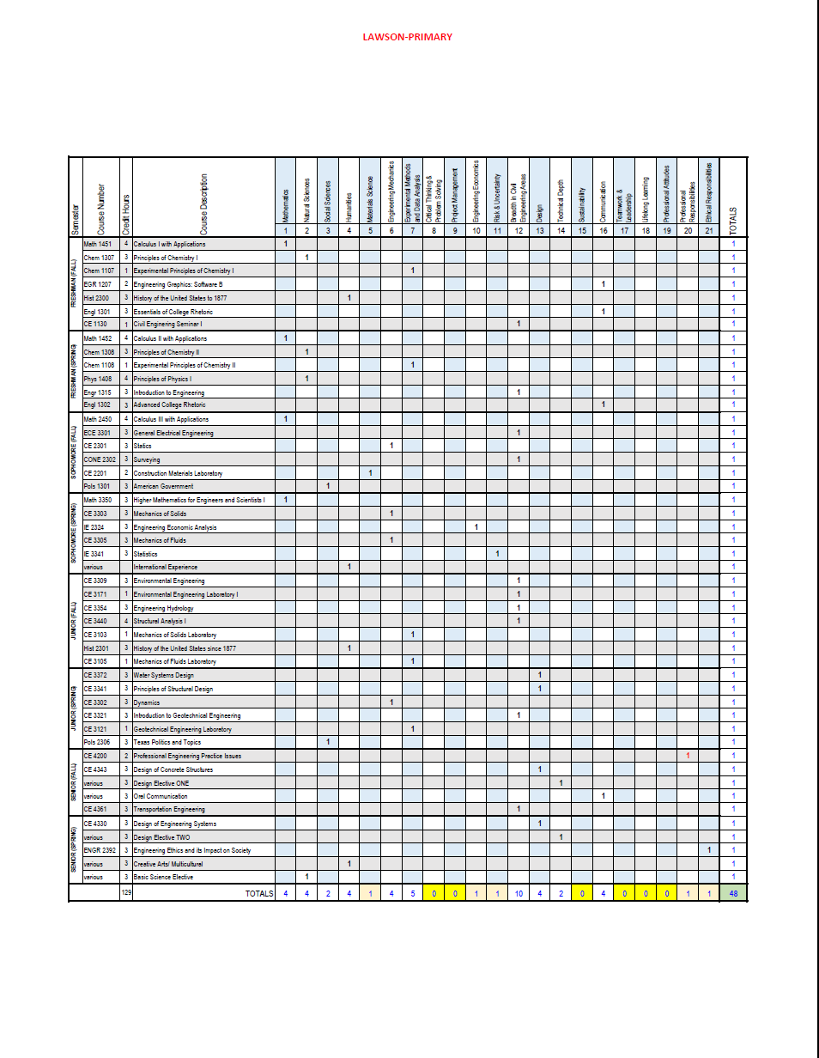
Recall Assignment 1, our review of BOK3E Outcomes?
…INCLUDED
…PRIMARY
48 courses…
21 outcomes…
CRITICAL THINKING & PROBLEM SOLVING

Slide 5

Critical Thinking… Definition
Critical thinking is the careful, deliberate determination of whether we should accept, reject, or suspend judgment about a claim – and of the degree of confidence with which we accept or reject it.
~ Moore & Parker

Slide 6
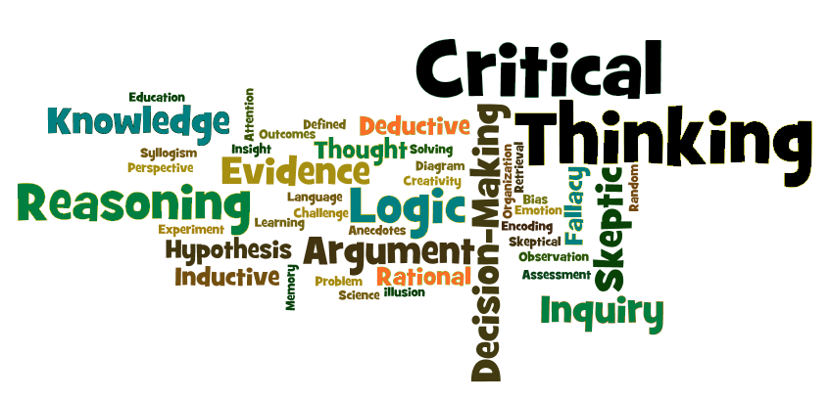
Judgment

Slide 7

LEGAL DEFINITION OF ENGINEERING
Engineering--The profession in which a knowledge of the mathematical, physical, engineering, and natural sciences gained by education, experience, and practice is applied with judgment to develop ways to utilize, economically, the materials and forces of nature for the benefit of mankind.
SUBCHAPTER F
§131.81 Definitions

Slide 8

EDUCATIONAL INSTRUCTION OF ENGINEERING
Student Outcomes – Student outcomes describe what students are expected to know and be able to do by the time of graduation. These relate to the knowledge, skills, and behaviors that students acquire as they progress through the program.

Slide 9
ABET Criterion 3. Student Outcomes
2018-2019 Criterion 3
The program must have documented student outcomes that support the program educational objectives. Attainment of these outcomes prepares graduates to enter the professional practice of engineering. Student outcomes are outcomes (1) through (7), plus any additional outcomes that may be articulated by the program.
an ability to identify, formulate, and solve complex engineering problems by applying principles of engineering, science, and mathematics
an ability to apply engineering design to produce solutions that meet specified needs with consideration of public health, safety, and welfare, as well as global, cultural, social, environmental, and economic factors
an ability to communicate effectively with a range of audiences
an ability to recognize ethical and professional responsibilities in engineering situations and make informed judgments, which must consider the impact of engineering solutions in global, economic, environmental, and societal contexts
an ability to function effectively on a team whose members together provide leadership, create a collaborative and inclusive environment, establish goals, plan tasks, and meet objectives
an ability to develop and conduct appropriate experimentation, analyze and interpret data, and use engineering judgment to draw conclusions
an ability to acquire and apply new knowledge as needed, using appropriate learning strategies.

Slide 10
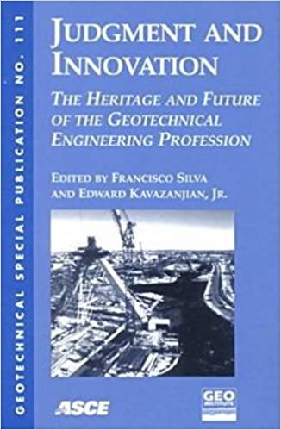
professional practice OF ENGINEERING
“The successful practice of engineering requires a high degree of engineering judgment.”
-Ralph B. Peck
“A Man of Judgment”

Slide 11
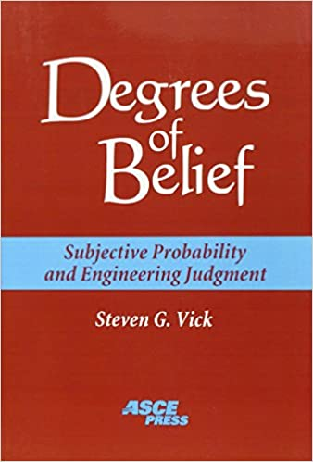
Judgment is the means by which “evidence is recognized, supporting evidence compiled, conflicting evidence reconciled, and evidence of all kinds weighed according to its perceived significance.”
-Steven Vick

Slide 12
A Case Study in [lack of] engineering judgment
FLORIDA INTERNATIONAL UNIVERSITY PEDESTRIAN BRIDGE COLLAPSE
Professional Engineering Practice Issues

Slide 13
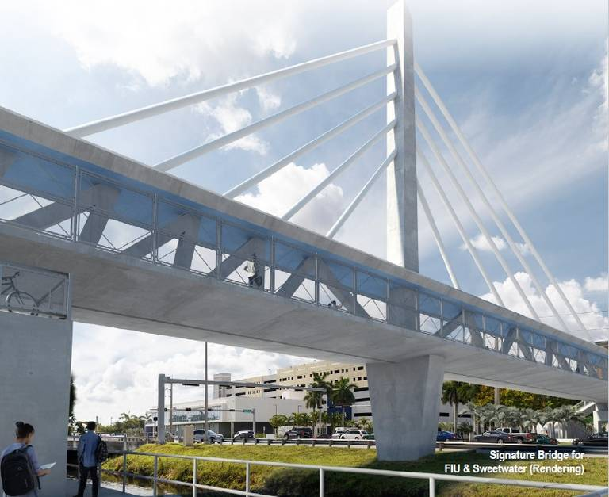

Slide 14


Slide 15
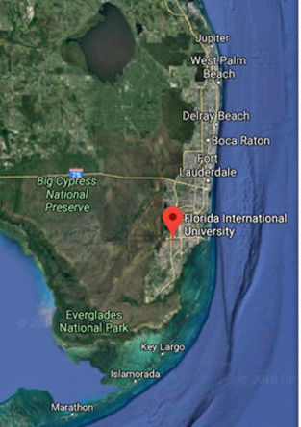
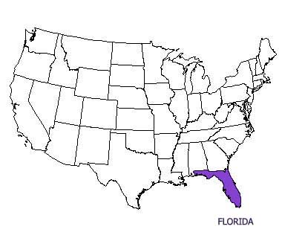

FLORIDA INTERNATIONAL UNIVERSITY
“A Top 50 Public Research University”
MIAMI, FLORIDA

Slide 16
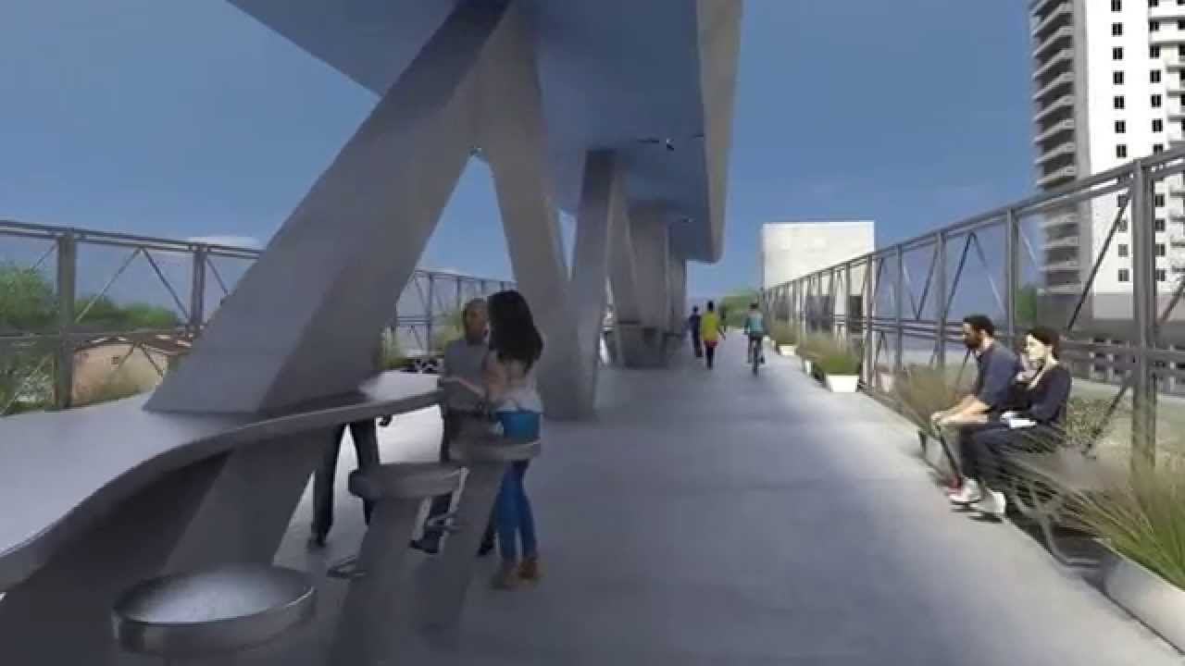
The pedestrian bridge was to serve as an elevated transit bridge for pedestrians and bicyclists crossing the travel lanes of SW 8th Street and the Tamiami Canal.
The main bridge section—spanning the south pier to the pylon pier—was 174 feet long, and the walking deck surface was elevated 18.5 feet.

Slide 17
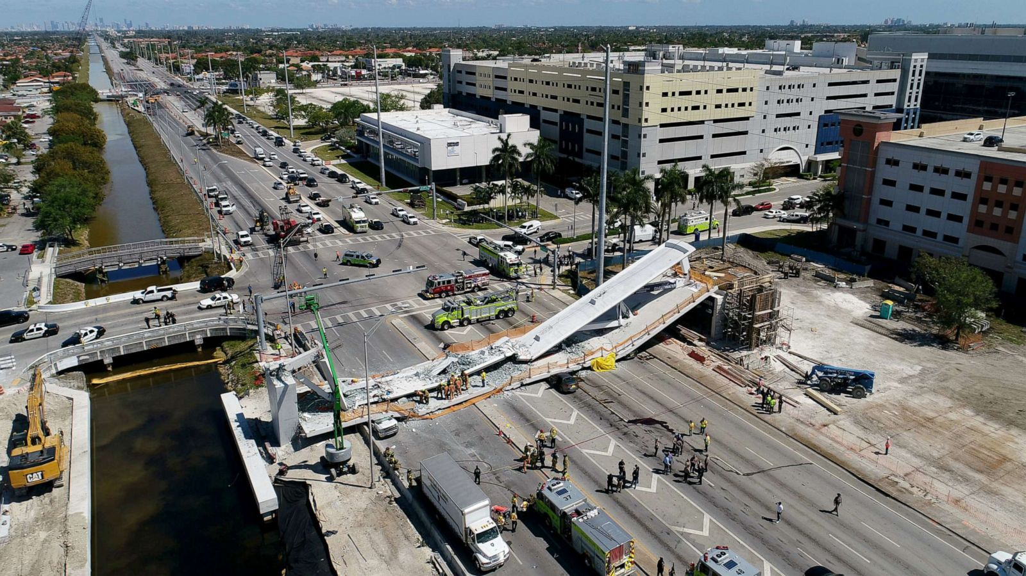
“On Thursday, March 15, 2018, about 1:46 p.m., a partially constructed pedestrian bridge crossing an eight-lane roadway in Miami, Florida, experienced a catastrophic structural failure in the nodal connection between truss members 11 and 12 and the bridge deck.”

Slide 18
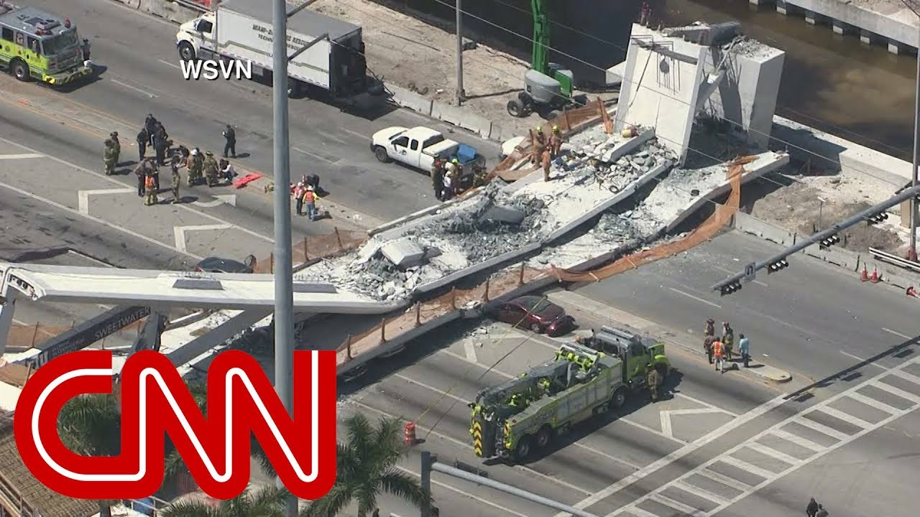
“The 174-foot-long bridge span fell about 18.5 feet onto SW 8th Street, which consists of four through travel lanes and one left-turn lane in the eastbound direction, and three through travel lanes in the westbound direction.”

Slide 19
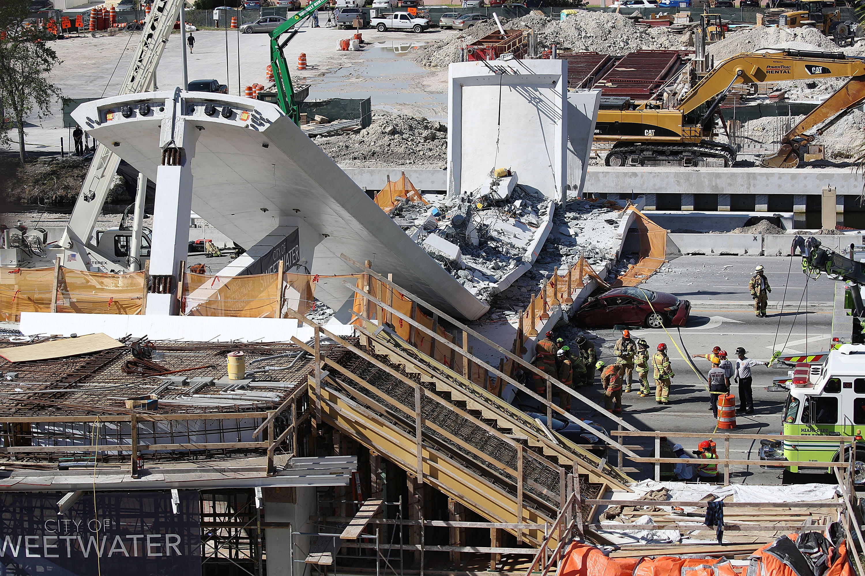
“Two of the westbound lanes below the north end of the bridge were closed to traffic at the time of the collapse; however, one westbound lane and all five eastbound lanes were open.”

Slide 20
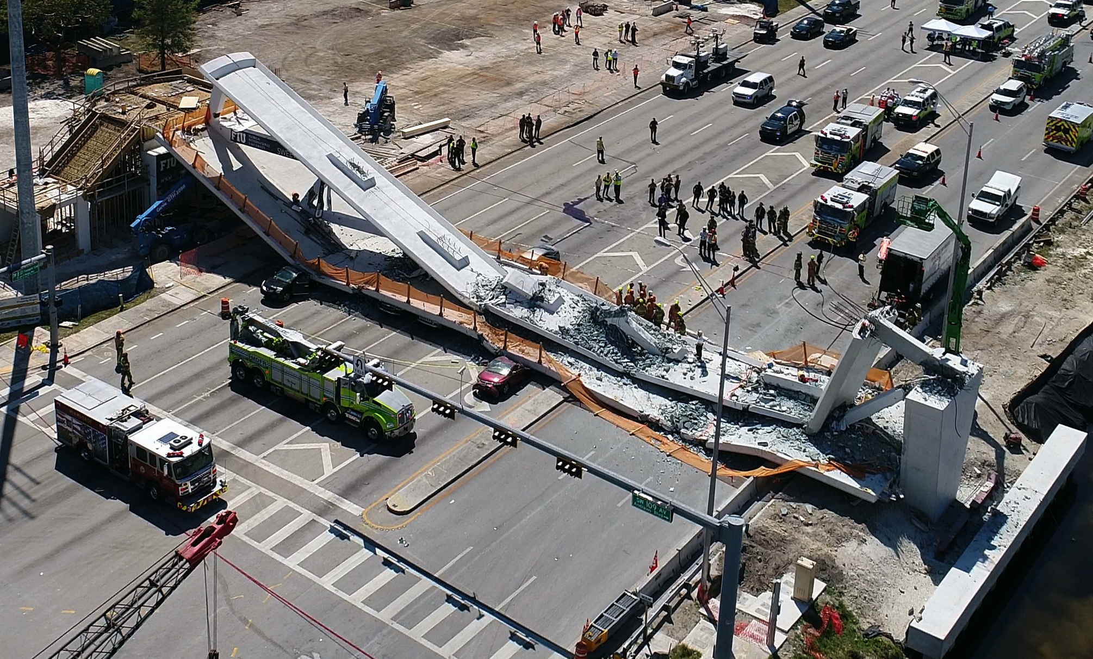
“On the day of the collapse, a construction crew was working on retensioning the post-tensioning rods within member 11, connecting the bridge canopy and the deck at the north end.”

Slide 21
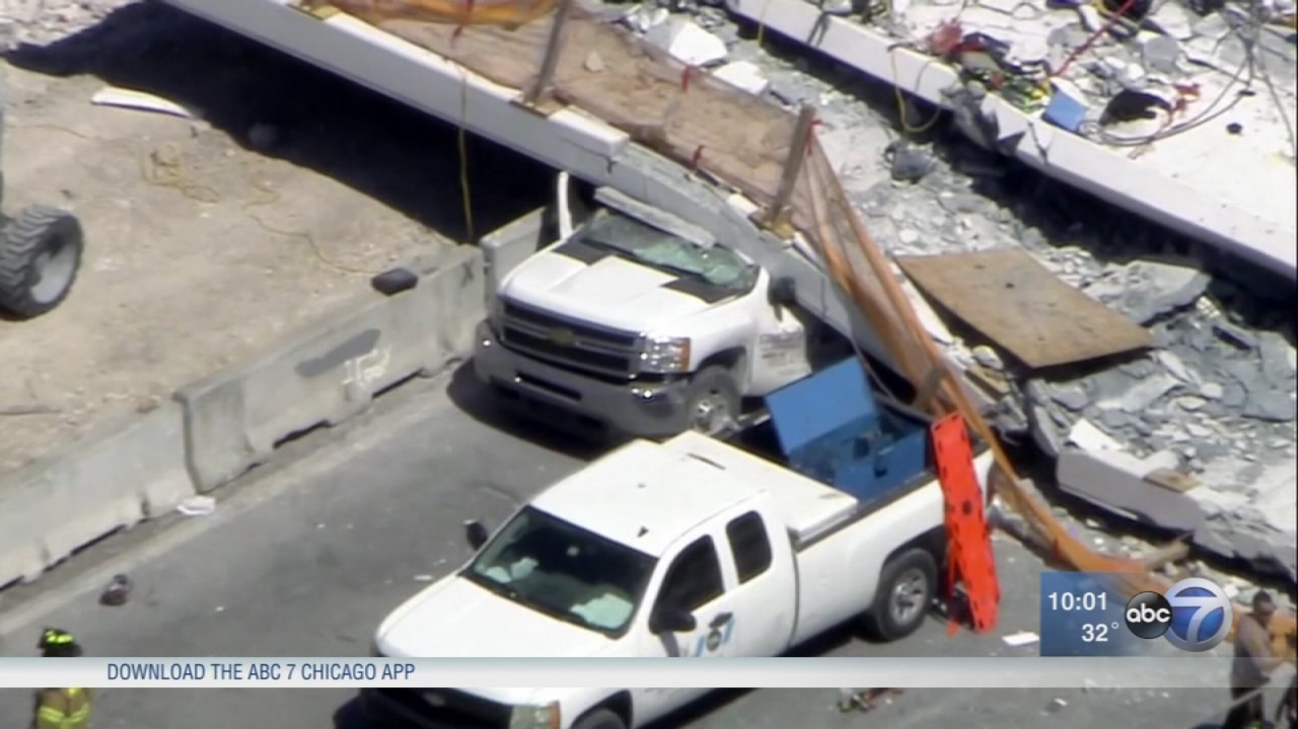
“Eight vehicles located below the bridge were fully or partially crushed. One bridge worker and five vehicle occupants died. Five bridge workers and five other people were injured.”

Slide 22



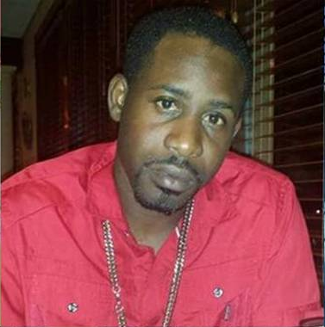
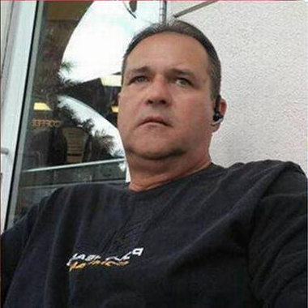


Alberto
Arias
Alexa
Duran
Navaro
Brown
Rolando Fraga
Hernandez
Brandon
Brownfield
Osvaldo
Gonzalez

Slide 23
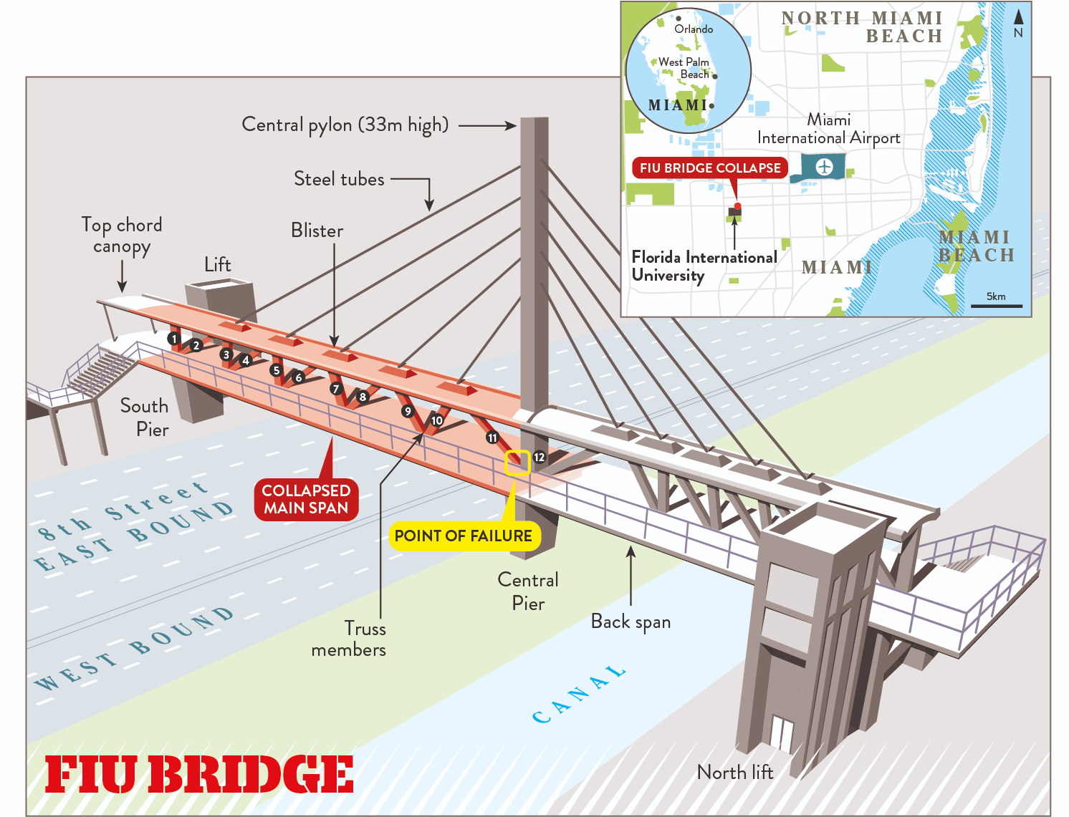

Slide 24
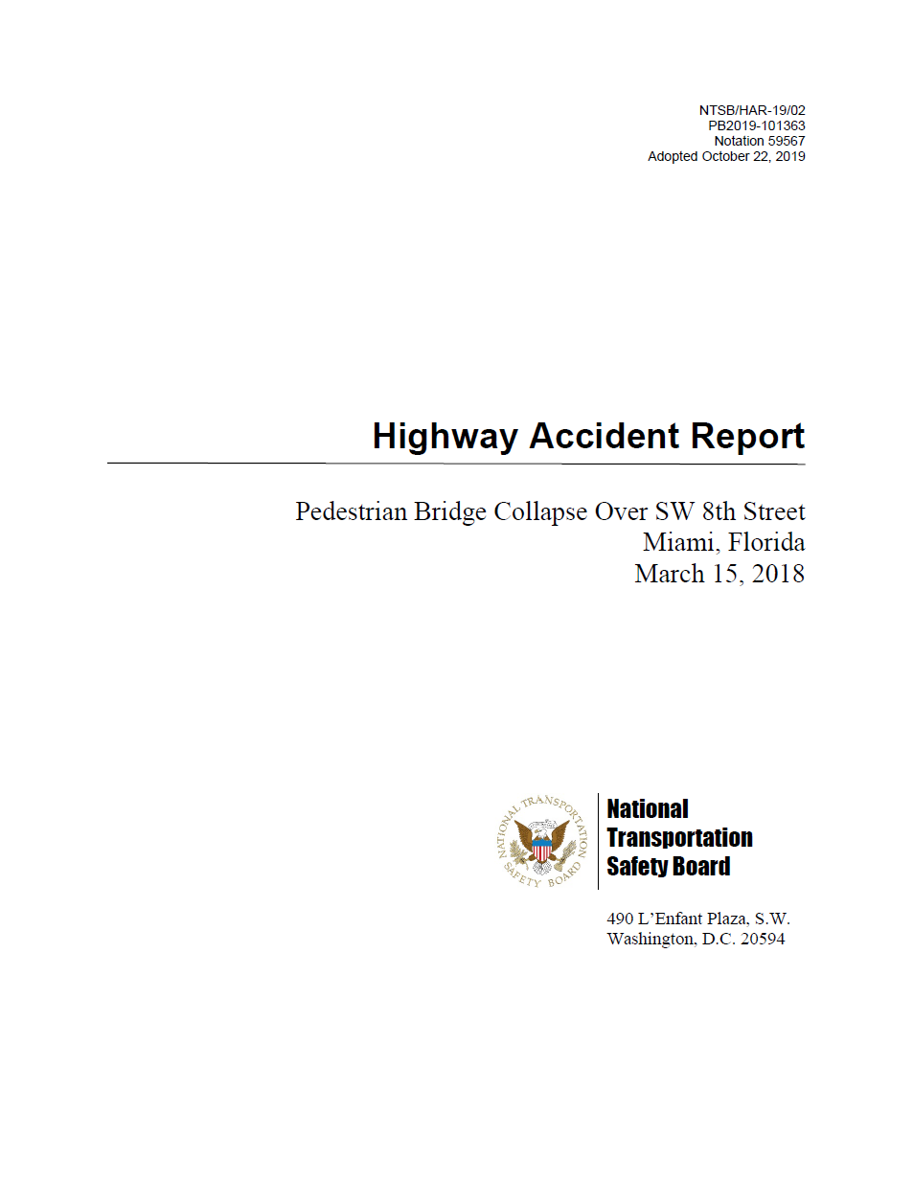

Slide 25
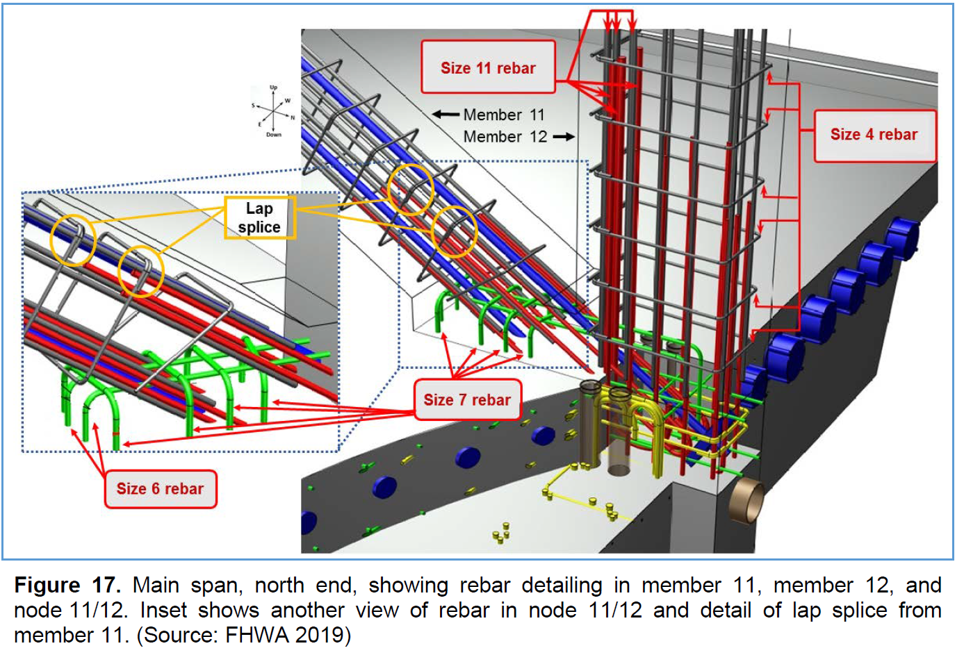
The investigation focused on the following safety issues: bridge design and construction plan errors, and unique bridge characteristics and mechanisms of failure; independent peer review of complex bridge design; shortcomings in oversight of evaluation of and response to significant observed bridge structure distress prior to collapse; and lack of redundancy guidelines in specifications for pedestrian and concrete truss bridges.

Slide 26

Highway Accident Report Pedestrian Bridge Collapse Over SW 8th Street Miami, Florida March 15, 2018
Executive Summary
Factual Information
Analysis
Conclusions
Recommendations
Board Member Statement

Slide 27
Probable Cause…
“The National Transportation Safety Board (NTSB) determines that the probable cause of the Florida International University (FIU) pedestrian bridge collapse was the load and capacity calculation errors made by FIGG Bridge Engineers, Inc., (FIGG) in its design of the main span truss member 11/12 nodal region and connection to the bridge deck. Contributing to the collapse…”

Slide 28
Excerpts from the report…
Section 2.3.1, Design of Bridge Nodal Regions: “FIGG used poor judgment when it determined that the bridge was a redundant structure…” (p. 72).
Section 2.3.3, FIGG Analytical Models: “FIGG used poor engineering judgment and… chose not to use the higher demand model results… and did not provide a rationale for the engineering judgment it used when selecting modeling results…” (p. 78).
Section 2.6, Shortcomings in Oversight of Evaluation of and Response to Significant Observed Bridge Structure Distress Prior to Collapse: “The EOR displayed poor engineering judgment by failing to recognize the extensive, large cracks observed in the member 11/12 nodal region as being abnormal for a reinforced concrete structure…” (p.92).
Section 2.6.2, Precollapse Decision to Retension Member 11: “the NTSB does not agree” that FIGG’s “judgment that returning the main span to its preexisting condition” was appropriate (pp. 94-95).

Slide 29
Excerpts from the report…
In addition to these specific instances, the NTSB report indicates that poor engineering judgment and response to precollapse cracking by the design-builder (Magnum Construction Management -MCM), the design consultant (FIGG), the construction project administrator/inspector (Bolton, Perez and Associates Consulting Engineers), the owner/construction project manager (Florida International University), and the Florida Department of Transportation (FDOT) contributed to the severity of the collapse outcome.

Slide 30
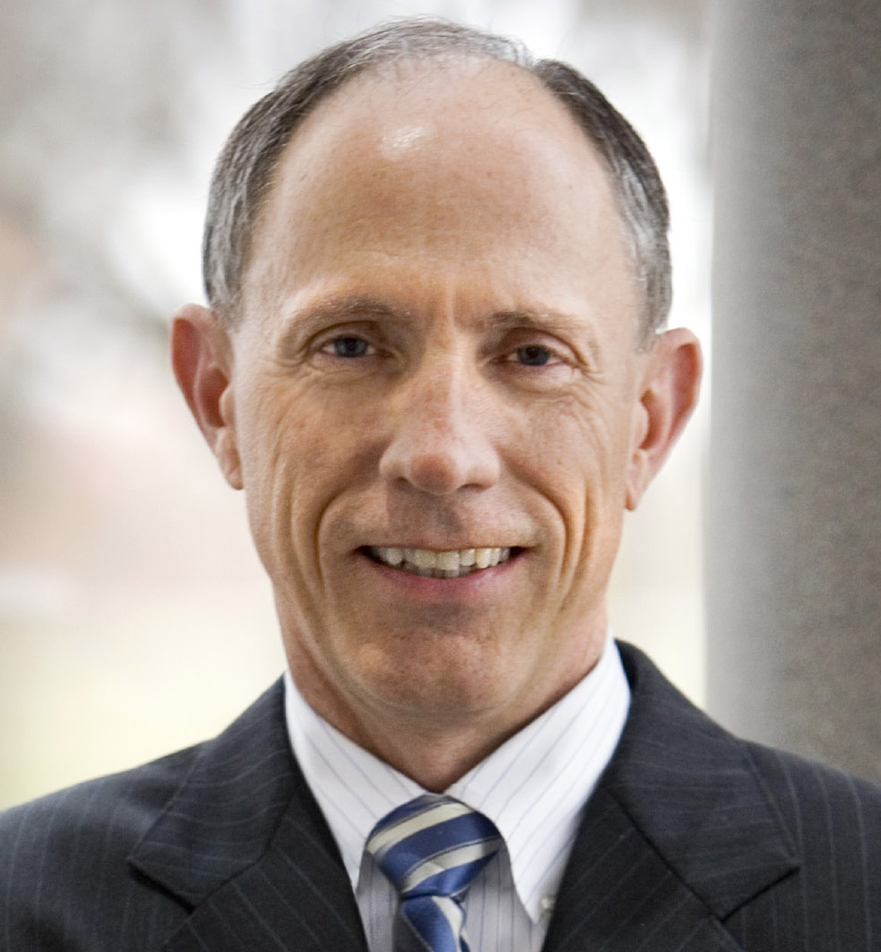
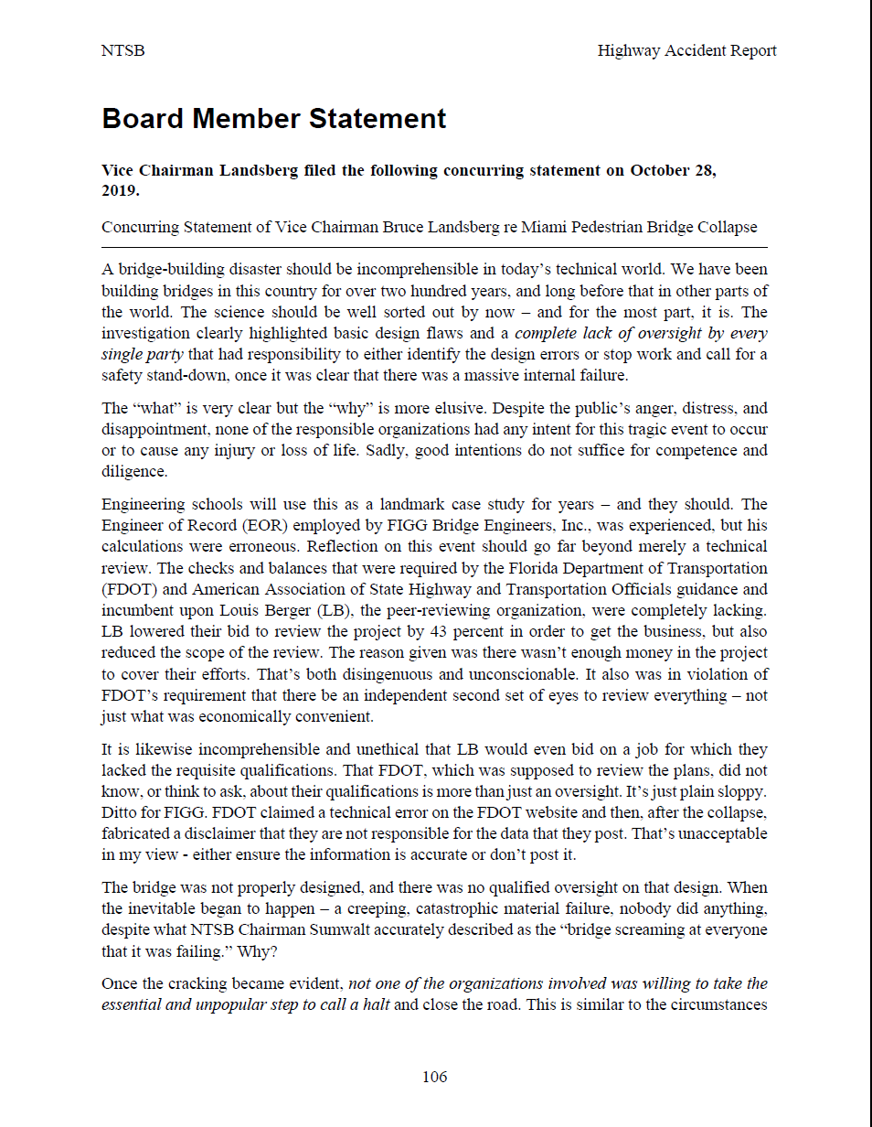

Slide 31
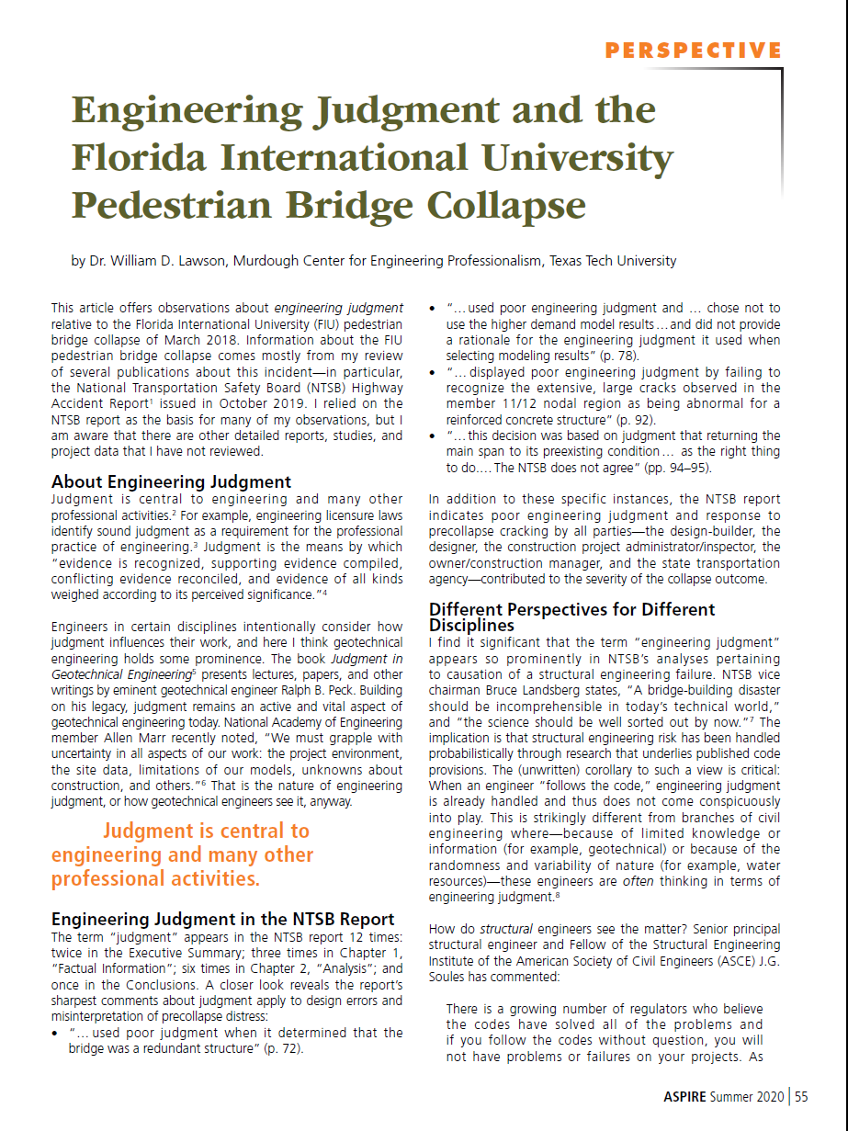

Slide 32
HOW WELL DO YOU UNDERSTAND THIS CONCEPT?
ENGINEERING JUDGMENT
Professional Engineering Practice Issues

Slide 33

Exercise 2.1 Meaning of “engineering judgment”
Please refer to “survey” handout. Provide responses to questions 1 through 10 (multiple choice).

Slide 34
Exercise 2.2 Meaning of “engineering judgment”
I think “engineering judgment” means:

Slide 35
Exercise 2.3 Meaning of “engineering judgment”
Discuss your definition of engineering judgment with 2 or 3 persons near you
Try to come up with an improved definition

Slide 36
SOME MISCONCEPTIONS
ENGINEERING JUDGMENT
Professional Engineering Practice Issues

Slide 37
Judgment for the engineering STUDENT
“[Engineering judgment] often appears to be an ingredient necessary for the solution of engineering problems, but one which s/he cannot acquire until later in her/his career by some process of absorption from his experience and his colleagues.”
-Ralph B. Peck
“A Man of Judgment”

Slide 38
Judgment for the engineering SCIENTIST
“[Engineering judgment] may appear to be a crutch used by practicing engineers as a poor substitute for sophisticated analytical procedures.”
-Ralph B. Peck
“A Man of Judgment”

Slide 39
Judgment for the PRACTICING engineer
“[Engineering judgment] may too often be an impressive name for guessing rather than for the collection of hard facts and for rational thinking.”
-Ralph B. Peck
“A Man of Judgment”

Slide 40
“These are all misconceptions. There actually is such a thing as engineering judgment and it is indispensable to the successful practice of engineering.”
-Ralph B. Peck
“A Man of Judgment”

Slide 41
SOME DEFINITIONS
ENGINEERING JUDGMENT
Professional Engineering Practice Issues

Slide 42
“Engineering judgment could be defined as the ability to recognize and/or predict, through a combination of intuition, insight and experience, the probable outcome of an analysis, design or process.”
-Bruhl, JC, JL Klosky, T Mainwaring, JP Hanus (2017)
US Military Academy at West Point

Slide 43
“When I hear the words ‘engineering judgement’, I know they are just going to make up numbers.”
-Richard Feynman (1988)
Acclaimed Physicist

Slide 44
“Engineering judgment is a creative act generated under constraints, and it proceeds not from abstract or general formulae, but from practical engagement.”
-Michael Davis (2012)
Illinois Institute of Technology

Slide 45
THANK YOU.

